Slide 1
ML Team 2 Final Presentation
STEM-Away July 2020
Tag Annotation Tool with Active Learning

Slide 2
Agenda
Team Introductions
Problem Statement + Product Requirement
Product Architecture
Data collection & Preprocessing
Modelling Approach & Evaluation
Tag Prediction Methods
Tag Annotator tool
Active Learning & Model improvement
Streamlit Deployment and UI
Future work
End-to-End Solution For Stemaway Tagging
Notes:
Saad

Slide 3







Team Introduction
Name: Saad Tariq
Title: Project | Product lead
Education: M.S. Industrial Engineering
School: New York University
Name: Soumya Goswami
Title: Technical Lead
Education: PhD ECE,
M.S. Data Science
School: University of Rochester
Name: Sai Likith
Title: Participant
Education: M.S. Computer science
School: New York University
Name: Shalini Kumari
Title: Participant
Education: B.S. Computer science
School: GLA University, India
Name: Hui Wen Goh
Title: Participant
Education: B.S. Mathematics
School: New York University
Name: Saad Ahmad
Title: Participant
Education: B.S. Computer Science, B.S. Business Marketing
School: University of Rochester
Name: Karandeep Kawatra
Title: Participant
Education: High School Senior
Notes:
Keep this the same

Slide 4
Problem Statement & Product Requirements

Slide 5

Problem statement
The current data on stemaway is either not tagged or tagged improperly
Tags missing
Tags missing
Tags missing
Notes:
Saad

Slide 6
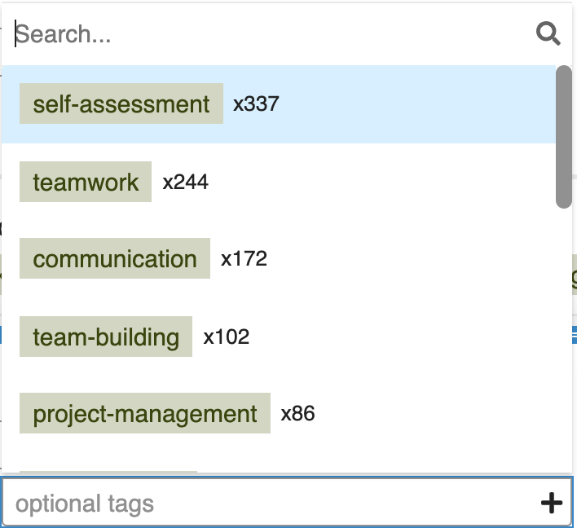
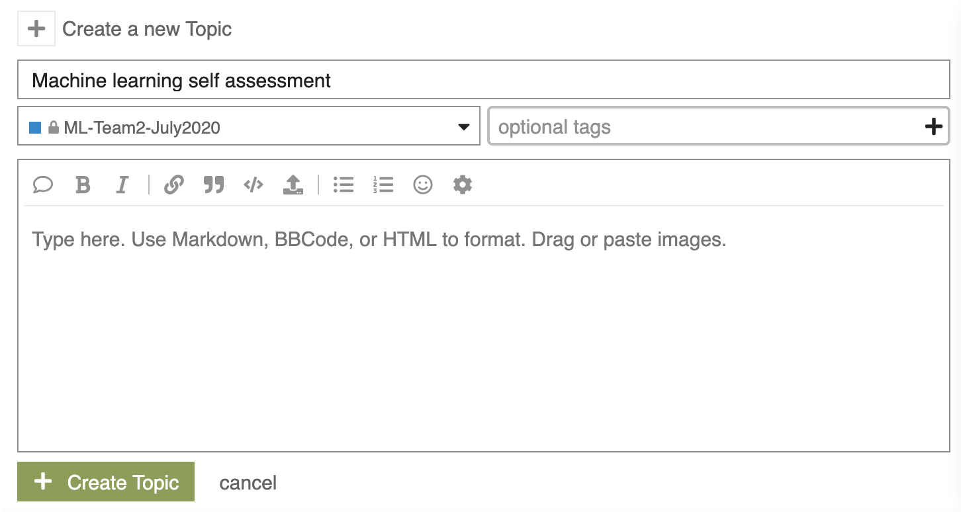
Problem statement
Tags suggested are not based on a model
The user interface does not encourage tagging
Relevant tags sometimes do not exist in the list
No way to use new stemaway data to improve tagging
Notes:
Need to explain why tagging is big deal for STEM-Away current version.

Slide 7
Product requirements
Tag recommendation model should have >70% accuracy
An annotator tool with a better user interface
Actively training loop
Notes:
Saad

Slide 8
Architecture

Slide 9
Product Architecture
Tag Recommendation Engine
Annotator
Active learning loop
Model
User comment
As test data
Stack exchange training data set
User choses tags
n predicted tags
Intermediary data set for active learning
User comment + tag annotated
Notes:
Saad

Slide 10
Data Scraping & Preprocessing

Slide 11
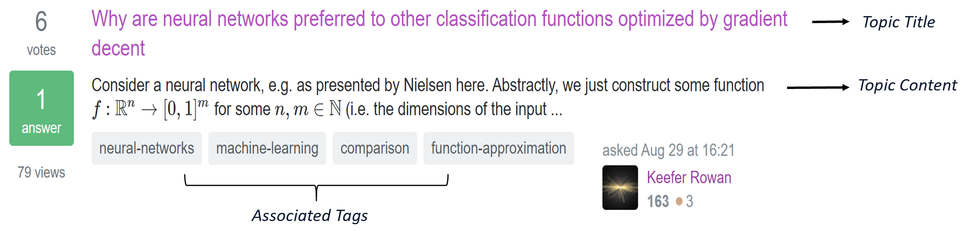
Web Scraping
Packages Used: Beautiful Soup (scraping html) and Selenium.Webdriver (crawling of web-page).
Stack Exchange Forum is chosen as it has publicly available online database & has lot of labelled tag data useful for analysis.
Notes:
Soumya
Why stack exchange
Stack exchange maintains a publicly available online database .
Has lot of labelled tags corresponding to posts.

Slide 12
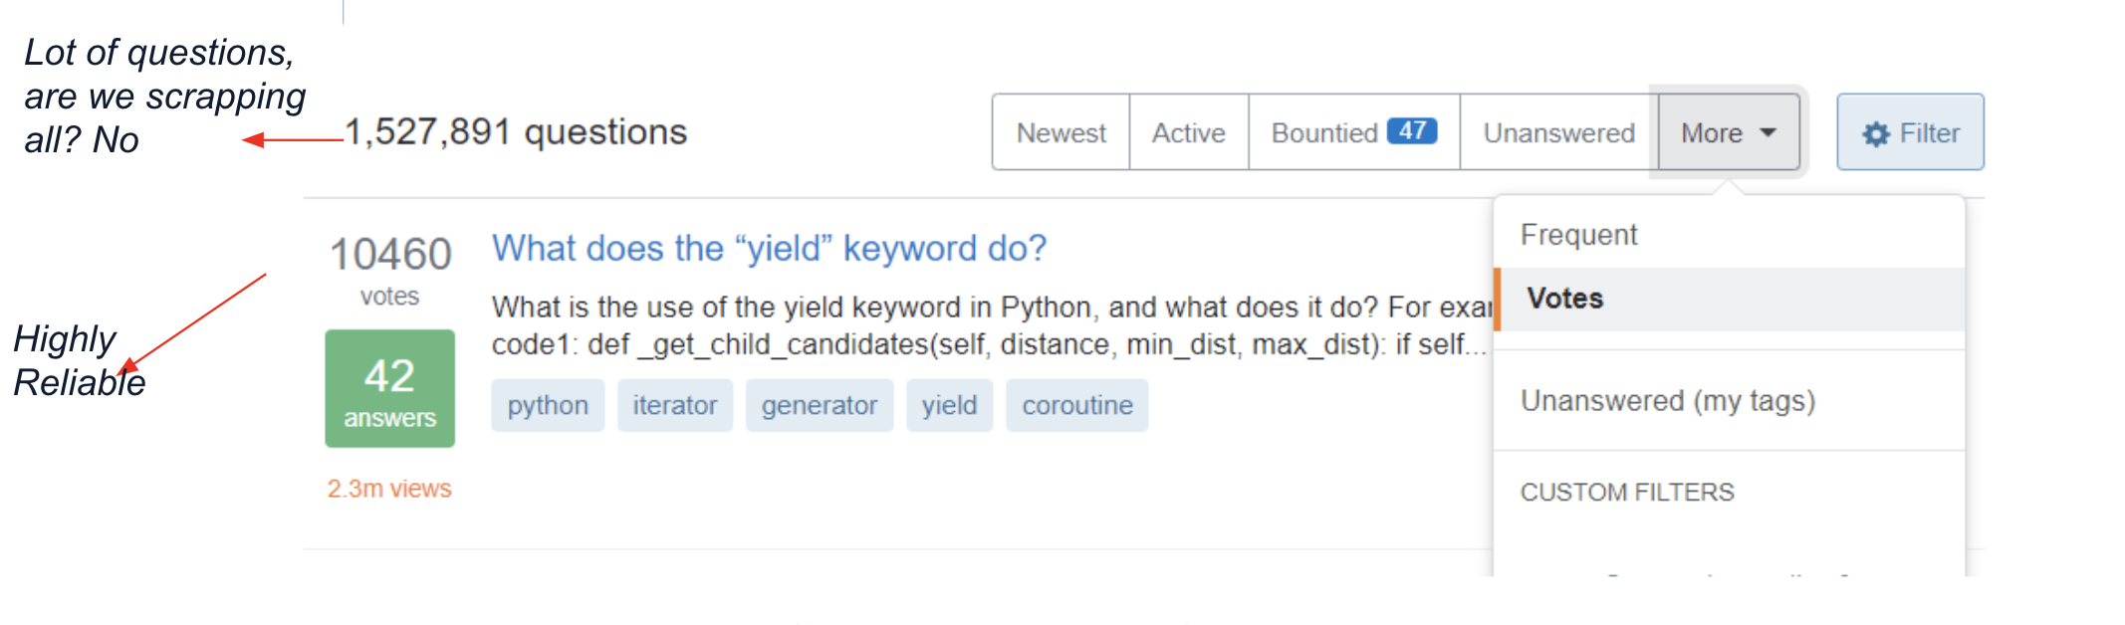
Reason for choice of Stack Exchange Forum
Lot of questions, are we scrapping all? No
Highly Reliable
Votes on questions in Stack Exchange forum gives us credibility.
Notes:
Soumya
Labelled tags present, We are trying to see the behavior of tags labelled to posts on stack exchange and see if we that behavior matches with other forum like stem-away.
Votes gives us credibility and data and tags are relevant
Vs STEM-Away :

Slide 13
Data collected
We collected 60,000 point data with topic titles, contents and associated tags.
Total, we have 480 machine learning tags.
TOPIC TITLE TOPIC CONTENT TAGS
Multiple Time Series Forecasting with limited data
I'm doing time series forecasting for the sales of an assortment of items. The data set I have contains two years of sales record of items that are may or may not still be selling.
machine-learning, time-series, dataset
Prediction of 480 tags from 60000 datapoints is challenging.
Notes:
Soumya

Slide 14
Preprocessing of Data
We processed the obtained texts to remove unwanted characters such as punctuations, numbers, spaces, tag links etc.
Consider the network with N neurons, each of which takes a 2×k2×k2 \times k input specified by the tuple (c⃗ t,θ⃗ t)(c→t,θ→t)(\vec c_t, \vec \theta_t) to produce output R⃗ tR→t\vec{R}_t through an update rule on the pairwise ...
consider the network with n neurons, each of which takes a 2 times k input specified by the tuple vec ct, vec thetat to produce output vecRt through an update rule on the pairwise
Before Preprocessing
e.g.-
After Preprocessing
e.g.-
Note: we have not removed single characters as some tags like ‘r’ or ‘c’ are present in our dataset.
Notes:
soumya

Slide 15
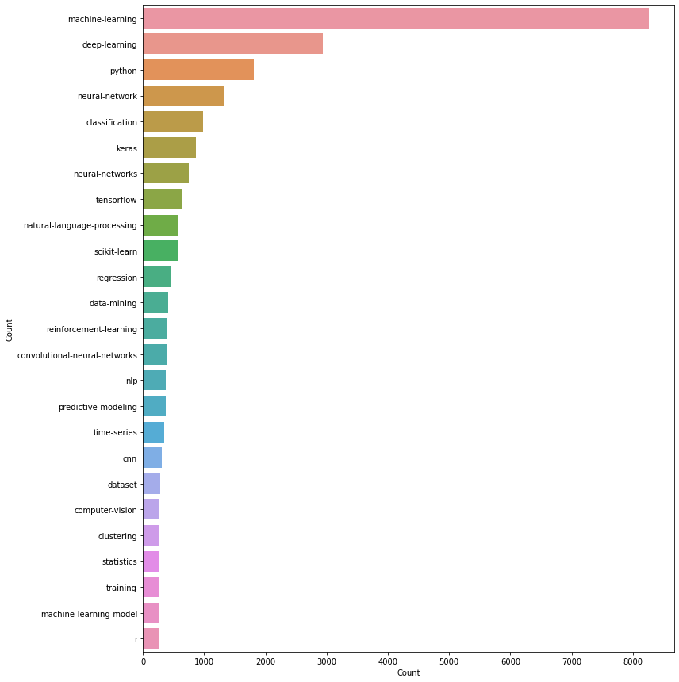
Tags Chosen: Approach
Prediction of 480 tags from 60000 datapoints is challenging.
Either need high dimensional features or large dataset for model prediction.
Based on frequency of occurrence of tags in the data, we reduced our tag set to 25-that reduced dataset to 11k
Note: machine learning tag is present in most of the data. So our data is not balanced. We need a probability based multi-label predictor ML model.
Notes:
Soumya

Slide 16
Modeling Approach and Results

Slide 17
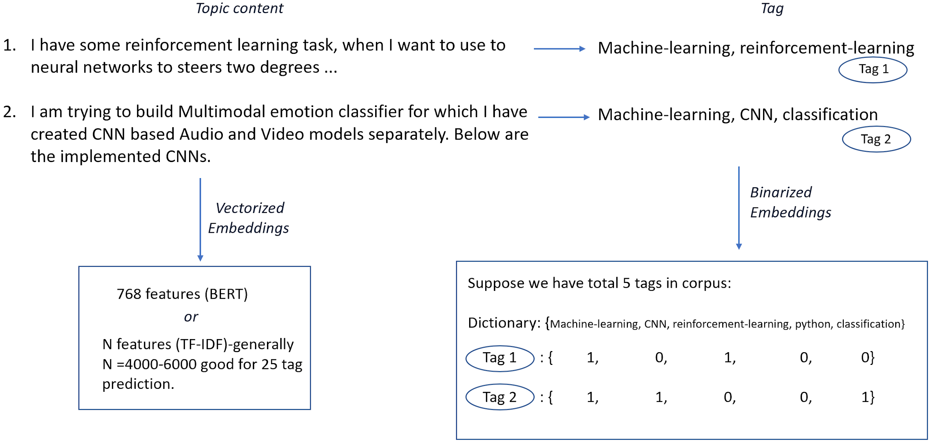
Multi-label prediction approach
Multi-Label classification is a type of classification in which we have to predict simultaneously a lot of things (here tags).
Notes:
Soumya
Simulataneously predicting lot of tags for a post

Slide 18
Multi-label prediction approach (Continued)
Three different models followed for multi-label prediction:
Topic vectorization by BERT + Feed-forward Neural Network Model
Topic vectorization by TF-IDF + Feed-forward Neural Network Model
Topic vectorization by TF-IDF + Logistic Regression
PROS: Bert gives contextual embedding. Embedding is independent of corpus data
CONS: Estimation of BERT features and training of NN is time-consuming. BERT gives fixed number of features..
PROS: Could vary number of features. TF-IDF embedding faster than BERT
CONS: NN is time-consuming.
PROS: Could vary number of features. TF-IDF embedding faster than BERT. Regression model is fast to train
CONS: Most regression models will not perfectly fit data.
Notes:
Soumya
Make this easier to read

Slide 19
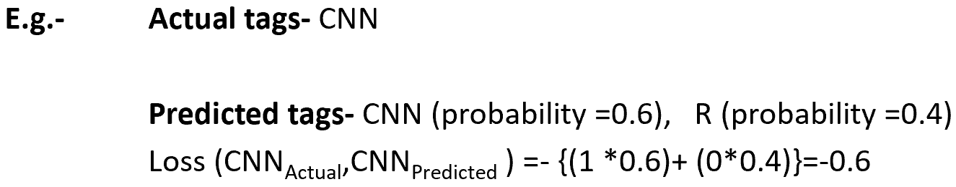
Accuracy and Cross-Entropy Loss Metric
no.of ((predicted_tags)==(actual_tags))
Accuracy=
No.of Samples
Binary Cross Entropy (test_tags, predicted_tag)=
-(test_tag*log(predicted_tag)+(1-test_tag)*(1-log(predicted_tag)))
Actual tag
(0 or 1)
Probability of prediction
Notes:
Soumya

Slide 20
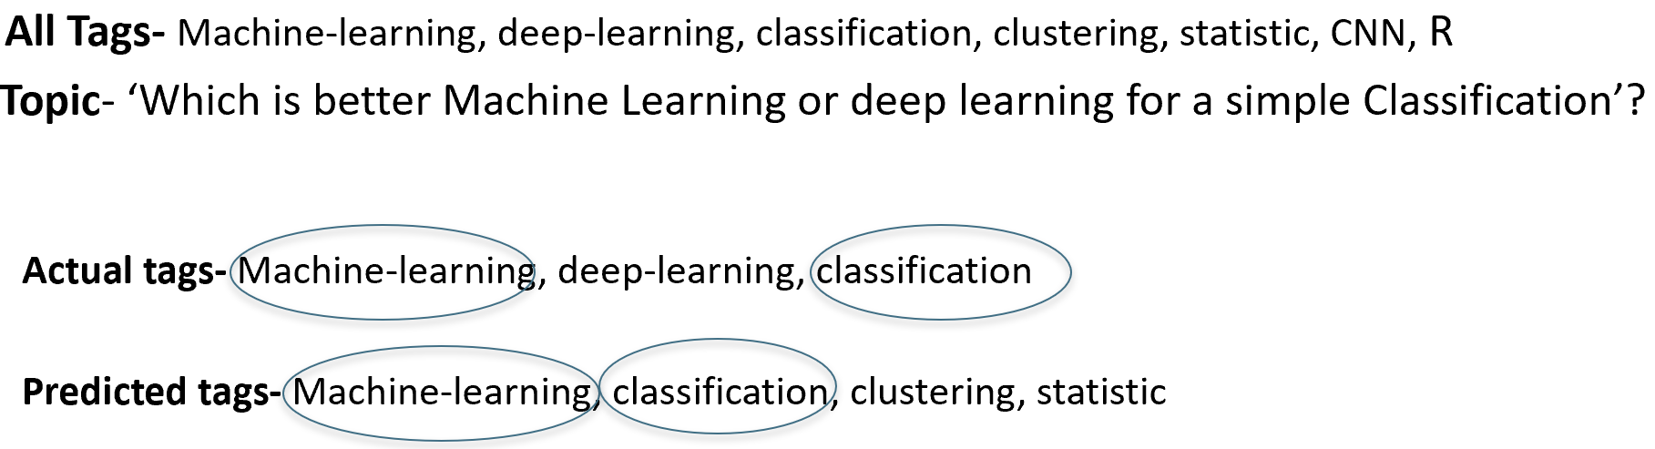
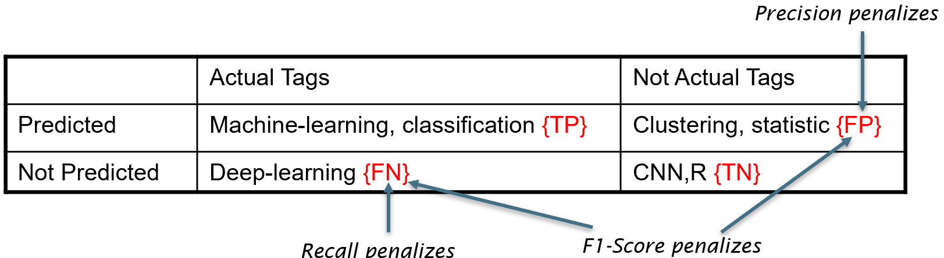
Evaluation Metrics (Precision, Recall, F1-score)
Precision (Tag):
TP / (TP + FP)
Penalizes tags (FP) that should not have been labelled in the prediction.
Recall (Tag ):
TP / (TP + FN)
Penalizes tags (FN) that should have been labelled in the prediction, but actually were not labelled
Harmonic mean of 2 penalizations
F1 Score (Tag ):
(2 * Precision * Recall) / (Precision + Recall)
Penalizes for both of the above cases
Notes:
Soumya
Precision and Recall ignores true negative set
F1-score has both false positive and false negative.

Slide 21
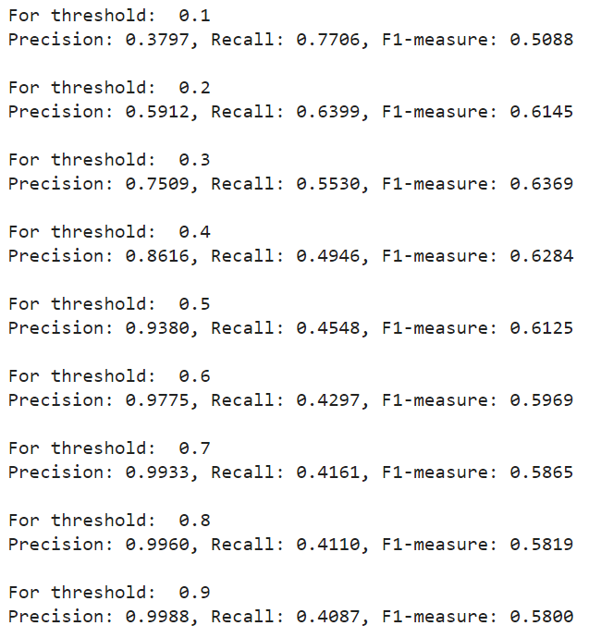
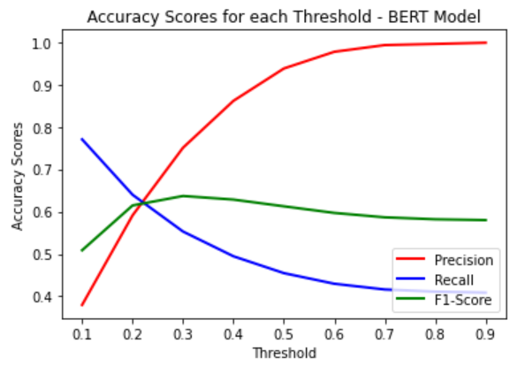
Results: BERT+ Feedforward NN
Notes:
Karandeep

Slide 22
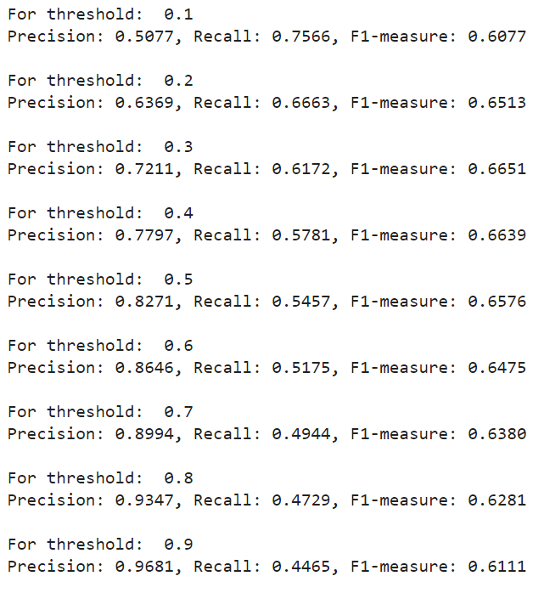
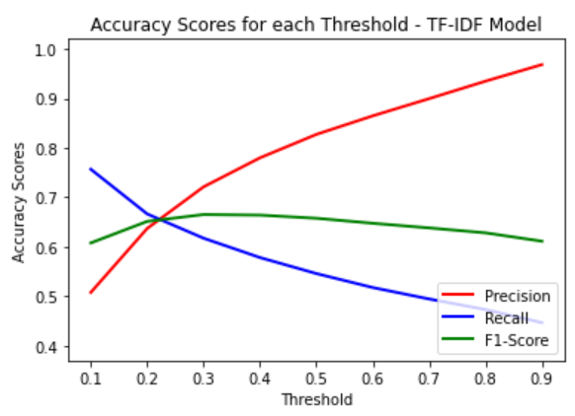
Results: TF-IDF + Feedforward NN
Notes:
Shalini

Slide 23
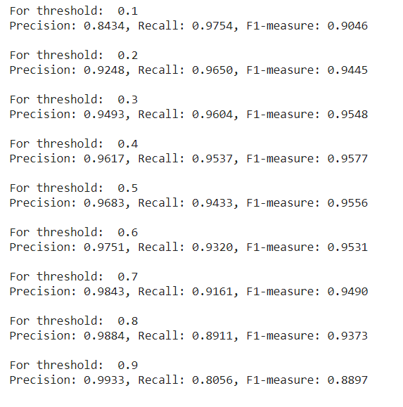
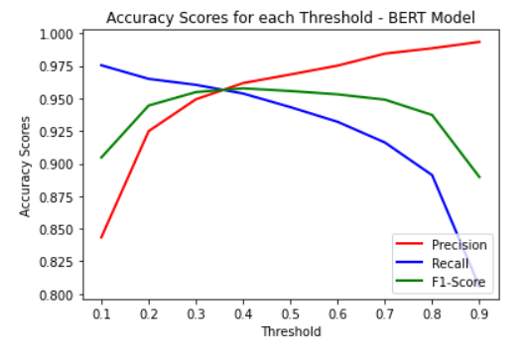
Results: TF-IDF + Logistic Regression
Notes:
Shalini

Slide 24
Prediction Methods

Slide 25
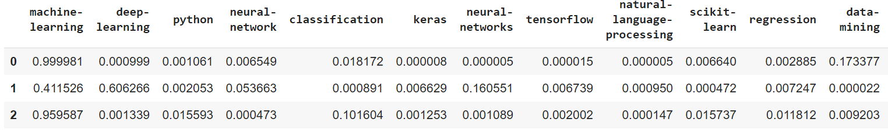
Prediction Methods
When the user inputs a post, the deep learning model will predict the probability of whether or not the 25 tags would be suitable for the post
Notes:
Hui wen

Slide 26
Prediction Methods
After obtaining the probabilities for each of the 25 possible tags from the deep learning model, we used two methods to obtain the final tag predictions:
Probability Thresholds
n-Most Likely Tags
Notes:
Hui wen

Slide 27
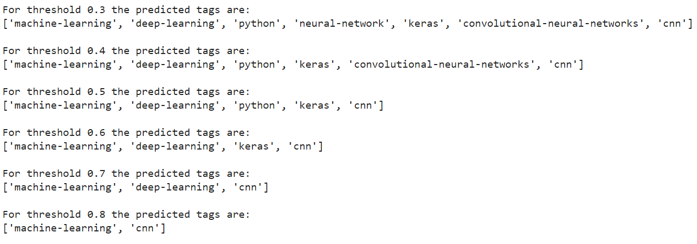
Prediction Methods: Probability Thresholds
If the probability of a tag for a particular post exceeds the given threshold, then it is predicted as a tag
How can I perform lossless compression of images so that they can be stored to train a CNN?
I have a set of images, which are quite large in size (1000x1000), and as such do not easily fit into memory. I'd like to compress these images, such that little information is missing. I am looking to use a CNN for a reinforcement learning task which involves a lot of very small objects which may disappear when downsampling…
deep-learning convolutional-neural-networks
Notes:
Hui wen

Slide 28
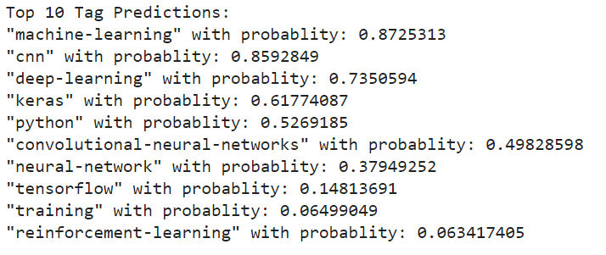
Prediction Methods: n-Most Likely Tags
This prediction method will output the top n number of tags that have the highest probability values as the predictions
In our instance, we chose the number to be 10:
Notes:
Hui wen

Slide 29
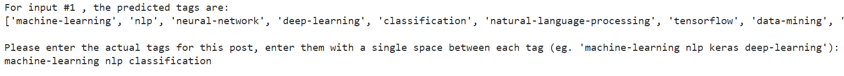
Tag Annotator: Input Tags by User
Users are given the top 10 predicted tags for their input post, they can then select the tags they think are relevant
The data and tags given by the user is then added to the dataset for further active learning and improvement of the tag predictor
“How to handle Tokenized text content which is given in number?
i have one data set of customer review, but the text data is given is tokenized text number. I am unable to proceed thinking about how to proceed? As I am encountering such data set the first time, so just need guide how to proceed. Well, in general case, machines do not understand the text, but they understand the numbers. Thus, we always tokenize the text followed by converting them to some form of numbers…”
Notes:
Huiwen

Slide 30
Active Learning

Slide 31
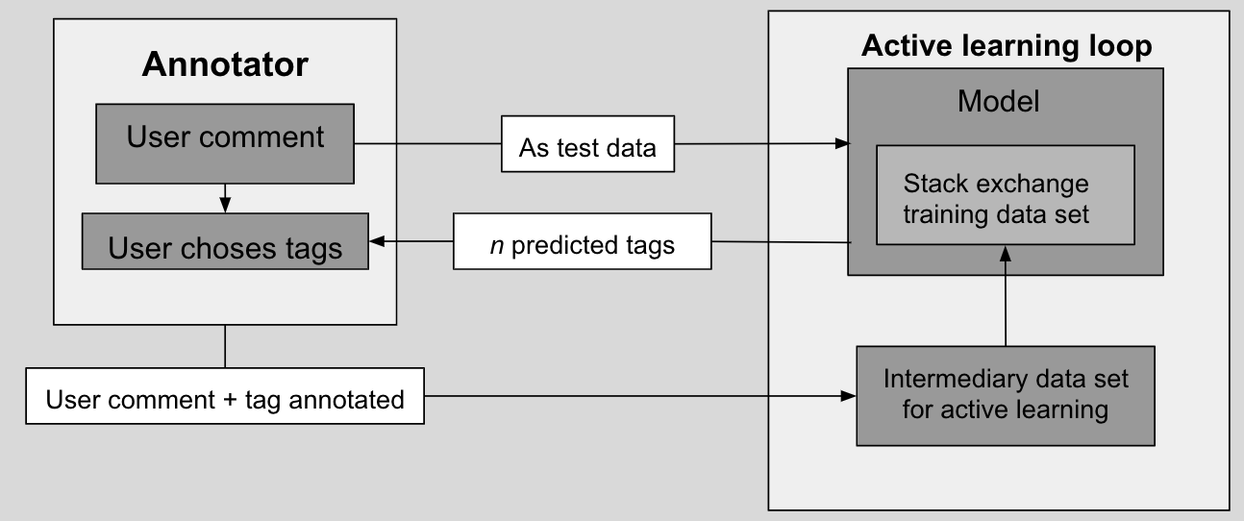
Active learning + Implementation
In the first stage, incoming text data is preprocessed using the original preprocessing function.
User specified parameter sets the threshold value for the number of new data points required for retraining.
Training set is modified with the addition of new data and model is retrained.
Model retraining on new data from STEM-Away forum improved model accuracy.
Notes:
Saad ahmed / Sai/Soumya

Slide 32
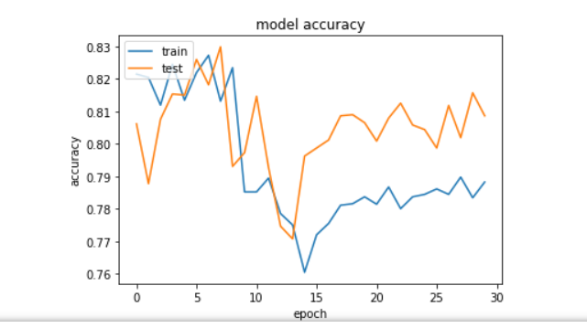
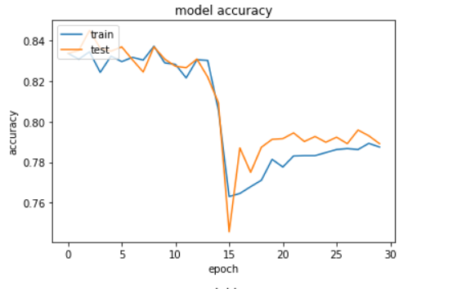
Model Accuracy Visualization
Before active learning
After active learning

Slide 33
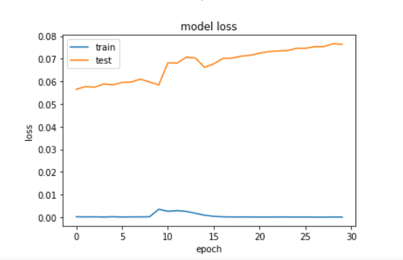
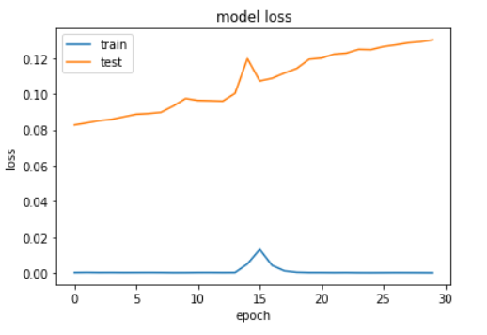
Model Loss Visualizations:
Before Active Learning
After Active Learning
Notes:
Before active learning vs after active learning

Slide 34
StreamLit Deployment & AWS

Slide 35
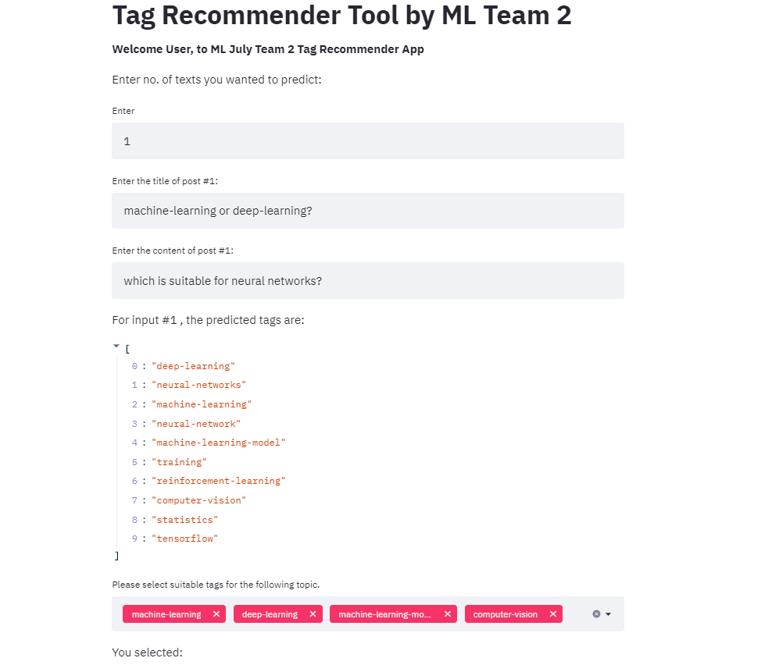
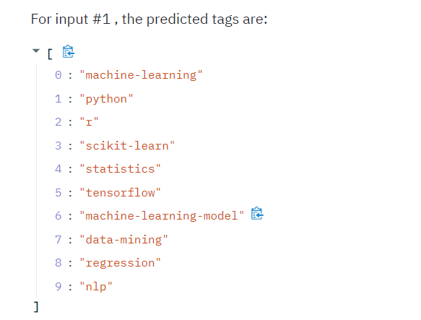
Example of the
final product
in use:
Notes:
Sai

Slide 36
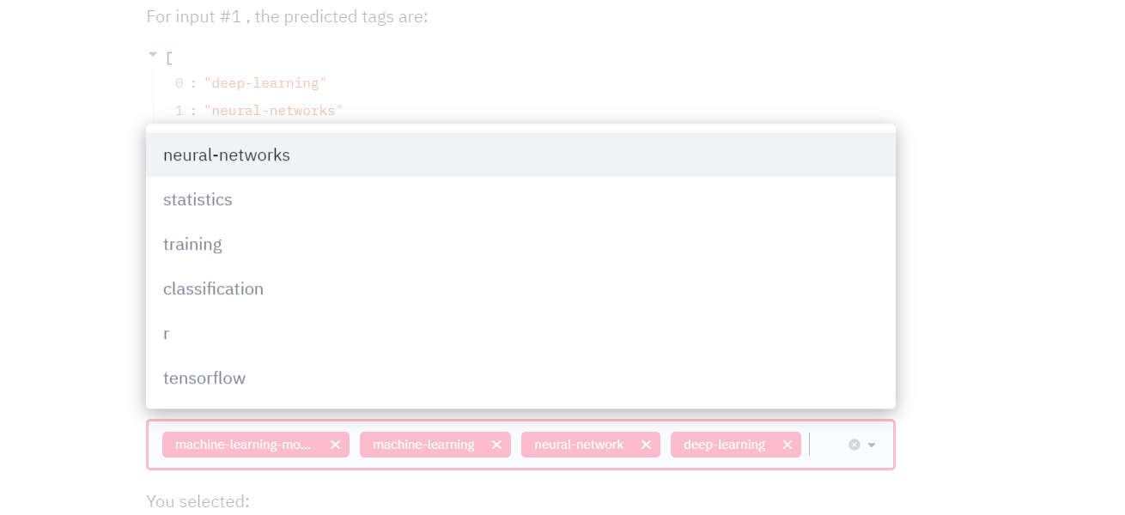
Actual tags from predicted tags list

Slide 37
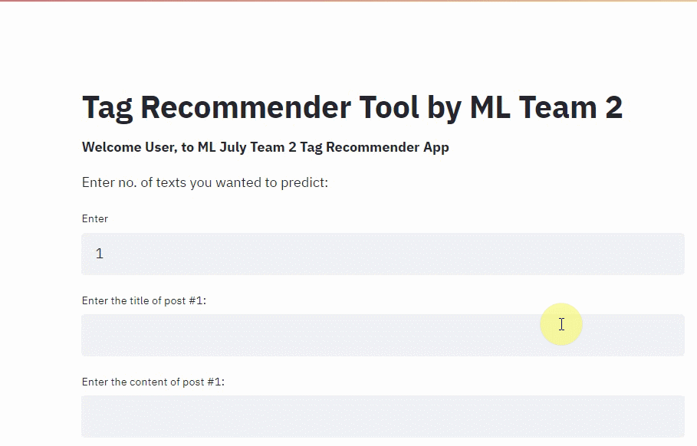

Slide 38
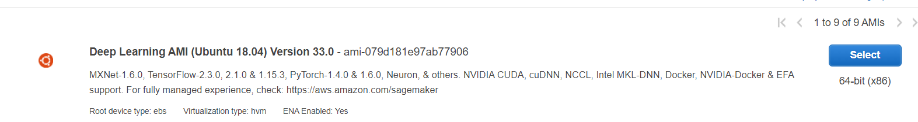
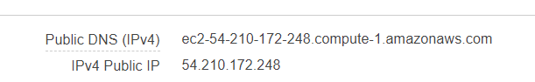
Why AWS?
Streamlit Performance is not up to the mark for large-scale data modelling. So, required GPU enabled Deep-learning instance.

Slide 39
Prediction on STEM-Away data: Illustration
Topic: Which is better? scikit-learn or tensorflow in machine learning?
Model built from Stack Exchange Data
Content:
Among the given two libraries which is better for building a better machine-learning model
STEM-Away Data as test Input
Notes:
Sai- Example of how this product can help STEM-Away

Slide 40
Challenges, Conclusion and
Future Scope

Slide 41
Challenges
Getting High Accuracy for Models >75 %
Tf-IDF implementation for user input
Integrating BERT into active learning
Notes:
Saad

Slide 42
Conclusions
We proposed a ML model to predict tags for each new text posted in the forum and a standard active learning architecture where an annotator is trained to label topics.
We used STEM-Away data in the annotator loop to validate our N-tag based recommender system.
We are training the model repeatedly after adding batches of data from the annotator loop using active learning model. That improves the prediction behavior with time.
# Accuracy score improvement before (79 %) vs after active learning loop (81%)
Notes:
Soumya
#put values on point 5 from slide 25

Slide 43
Improvements + future works
We can use this proposed model to predict tags on Stem-Away data. This model does not require the pre-labelled tags on STEM-Away data.
A future work could be to get a tag generation/formation system (predicting new tags) with deep learning.
Use Flask instead of StreamLit
User-based variation effect on tag prediction: If two different users give different tags to a same text during annotation how does it affect the model?
Notes:
Soumya
Since it is trained from Stack Exchange, it can predict on STEM-Away without labels also.

Slide 44
End-to-End Tagging Solution For Stemaway
Tag Recommendation Engine
Annotator
Active learning loop
Model
User comment in stemaway
As test data
Project 1’s output dataset
User choses tags
n predicted tags
Intermediary data set for active learning
User comment + tag annotated
Notes:
Saad

Slide 45
Thank You!
Q & A

